Slide 1


CAPSTONE PROJECT
Smart Student Performance Insights Dashboard
Presented By
Student Name: Nellore Sukumar
College Name: Vikrama Simhapuri University
Department: Computer Science
Email ID:nelloresukumar2004@gmail.com

Slide 2
Introduction :
Education institutions collect large amounts of student performance data. However, analyzing this data manually is difficult and time consuming.
A dashboard helps visualize student performance using charts and graphs, making it easier for teachers and administrators to understand patterns and trends.
This project focuses on creating a Student Performance Analysis Dashboard to analyze student scores effectively.

Slide 3
Problem Statement :
Educational institutions store large volumes of student data.
Problems include:
• Difficult to analyze student performance manually • Hard to identify performance patterns • Teachers cannot easily compare scores • Lack of visual representation of data
A data visualization system is required to solve these problems.

Slide 4
Proposed Solution :
The proposed solution is to develop a Student Performance Analysis Dashboard that helps educators analyze academic performance using data visualization techniques.
The dashboard provides a clear and interactive interface where users can easily understand student performance through graphical representations.
The system helps to:
• Visualize student scores using charts and graphs • Compare performance across different categories such as gender, ethnicity, and parental education • Identify trends and patterns in academic performance • Analyze subject-wise performance including math, reading, and writing • Monitor average scores and overall performance levels • Provide quick insights using interactive dashboard elements
The dashboard also includes filtering options that allow users to analyze specific data segments. This makes it easier for teachers and administrators to explore the data and identify areas where students need improvement.
By using data visualization techniques, the system transforms raw data into meaningful insights that support better academic planning and decision making.

Slide 5
Dataset Explanation :
The dataset contains student academic performance information.
Key attributes include:
• Student ID • Gender • Ethnicity • Parental Level of Education • Test Preparation Course • Math Score • Reading Score • Writing Score
This dataset is used to analyze and visualize student performance patterns.

Slide 6
Technology Stack:
The following technologies were used to develop the project:
Data Source Student Performance Dataset (Excel)
Data Processing Microsoft Excel
Visualization Tool Power BI
Charts Used
• Bar Chart • Pie Chart • Donut Chart • KPI Cards • Performance Comparison Charts

Slide 7
System Development Approach :
The project follows the following steps:
Data Collection Student dataset collected from Excel.
Data Cleaning Unnecessary values removed and data formatted.
Data Analysis Scores analyzed based on gender, ethnicity and parental education.
Dashboard Creation Interactive charts created using Power BI.
Performance Visualization Dashboard shows student performance insights.

Slide 8
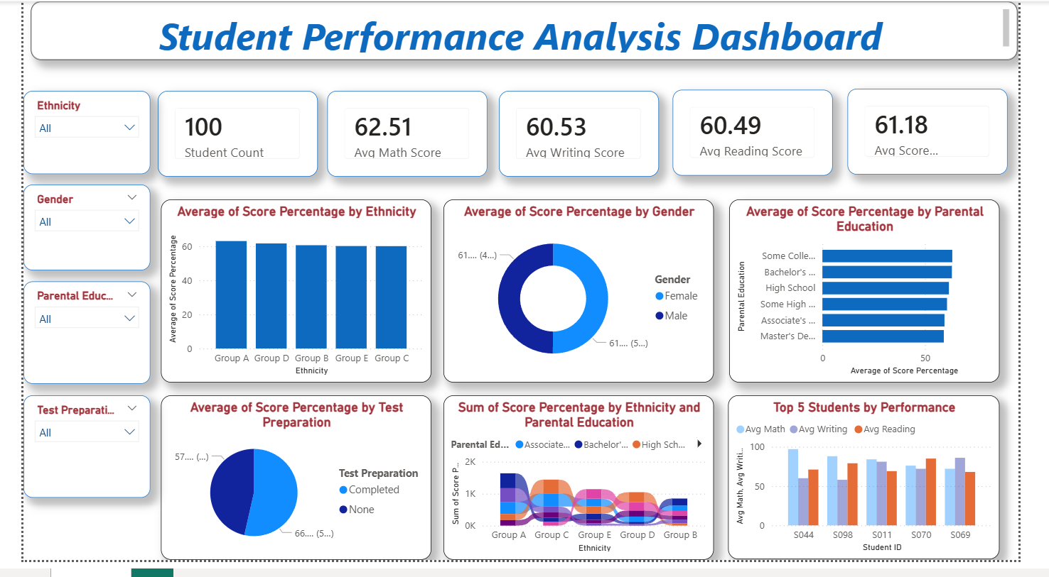
Dashboard :
The dashboard includes:
Student count KPI
Average scores
Gender comparison
Ethnicity comparison
Test preparation impact

Slide 9
Results :
The dashboard successfully visualizes student performance data.
Key outcomes:
• Easy understanding of student score patterns • Identification of high performing students • Comparison of performance between categories • Interactive filtering improves analysis
This helps educators make better academic decisions.

Slide 10
Conclusion :
The Student Performance Analysis Dashboard provides an effective way to analyze student data.
The system helps educators identify trends and evaluate academic performance quickly.
Using data visualization tools like Power BI improves decision making and enhances educational insights.

Slide 11
Future Scope :
Future improvements may include:
• Real-time student data integration • AI-based performance prediction • Web-based dashboard deployment • Integration with school management systems

Slide 12
References :
• Microsoft Power BI Documentation • Student Performance Dataset • Data Visualization Techniques
GITHUB LINK :

Slide 13
Thank You

